Slide 1


D.Y. PATIL COLLEGE OF
ENGINEERING, AKURDI , PUNE.
Department of Computer Engineering
Topic of Mini-Project :- Voting system for General Elections
PBL - 2
Semester 4
(Class:- SE-A)
A.Y – 2023-24
Group No-4
Members
Himanshu Gaikwad (SECO2324A006)
Abhishek Ambekar (SECO2324A005)
Ashwin Patil (SECO2324A008)
Prashant Shejwal (SECO2324A018)
Project guide :-Mrs. Dhanashree Phalke

Slide 2



DYPCOE_AKURDI VOTING SYSTEM FOR GENERAL ELECTION PBL 2 SEM 4
INDEX
01
INTRODUCTION
02
PROBLEM STATEMENT
03
OBJECTIVES
04
MOTIVATION
05
SCOPE
06
SOCIAL IMPACT
07
HARDWARE REQUIRED
08
SOFTWARE REQUIRED
09
INTENDED USER
10
ARCHITECTURE DIAGRAM
11
REFERENCES

Slide 3

DYPCOE_AKURDI VOTING SYSTEM FOR GENERAL ELECTION PBL 2 SEM 4
Problem statement
Design and Implement an Innovative and Secure Voting System for General Elections to Enhance Accessibility, Transparency, and Trust in the Democratic Process.

Slide 4
DYPCOE_AKURDI VOTING SYSTEM FOR GENERAL ELECTION PBL 2 SEM 4
Introduction
Topic :- Voting system for general elections
Essential democratic mechanism
Democratic Principles
Legitimacy of Representation
Trust in Democratic Process
Technological Advancements
Challenges Addressed

Slide 5
DYPCOE_AKURDI VOTING SYSTEM FOR GENERAL ELECTION PBL 2 SEM 4
Program outcomes
PO-01 (Engineering Knowledge)
PO-02 (Problem Analysis)
PO-03 (Design / Development of Solutions)
PO-04 (Conduct Investigation of Complex Problems )
PO – 05 (Modern Tool Usage)
PO– 06 (The Engineer and Society)
PO-08 (Ethics)
PO-09 (Individual and Teamwork)
PO-10 (Communication Skills)
PO– 11 (Project Management and Finance)
PO– 12 (Life-long Learning)

Slide 6
DYPCOE_AKURDI VOTING SYSTEM FOR GENERAL ELECTION PBL 2 SEM 4
OBJECTIVES
To Facilitate Secure and Transparent Voting
To Providing a user-friendly platform for organizing and conducting internal elections or polls.
To Reduce Voting Fraud and Irregularities
To Enhance Accessibility and Convenience for Voters
To Provide Timely and Accurate Election Results

Slide 7
DYPCOE_AKURDI VOTING SYSTEM FOR GENERAL ELECTION PBL 2 SEM 4
MOTIVATION
Addressing Voting Irregularities
Our project stems from the desire to streamline and democratize the selection process within organizations
Streamlining the Election Process without Internet Dependence
By implementing face recognition technology, we aim to enhance security and accuracy while reducing administrative burdens.

Slide 8
DYPCOE_AKURDI VOTING SYSTEM FOR GENERAL ELECTION PBL 2 SEM 4
SCOPE
The voting system is designed to cater to the voting needs within the confines of schools, institutes, and companies, ensuring a streamlined and efficient voting process at the organizational level.
Conducting testing and validation to ensure the reliability and usability of the voting system in diverse organizational settings.

Slide 9
DYPCOE_AKURDI VOTING SYSTEM FOR GENERAL ELECTION PBL 2 SEM 4
SOCIAL IMPACT
Confidence: Reducing online hacking concerns, building trust in the electoral system.
Transparency : It is a key factor for supporting a credible election in which each step is open to scrutiny by members and staff .
Efficiency & Time Saving : Streamlining the voting process through online systems can save time for both voters and election officials, potentially leading to more efficient and timely election results.
Notes:
9
DATE
DYPCOE VOTING SYSTEM FOR GENERAL ELECTION PBL2 SEM 4
08-02-2024

Slide 10
DYPCOE_AKURDI VOTING SYSTEM FOR GENERAL ELECTION PBL 2 SEM 4
HARDWARE REQUIRED
Minimum Hardware required
Processor (Intel i5)
Webcam
RAM (4GB)
Hard Disk (4GB)

Slide 11
DYPCOE_AKURDI VOTING SYSTEM FOR GENERAL ELECTION PBL 2 SEM 4
SOFTWARE REQUIRED
CODE EDITOR :
VS Code
Pycharm
FRONTEND DEVELOPMENT:
HTML
CSS
BACKEND DEVELOPMENT:
PHP
DATABASE :
MySQL
AI :
Python (Face Recognition)
.

Slide 12
DYPCOE_AKURDI VOTING SYSTEM FOR GENERAL ELECTION PBL 2 SEM 4
INTENDED USERS
Administrators and organizers responsible for managing internal elections or polls within their organizations.
Employees, students, or members eligible to participate in voting processes.
Developers and IT professionals involved in implementing and maintaining the voting system.
Educational Institutions

Slide 13






DYPCOE_AKURDI VOTING SYSTEM FOR GENERAL ELECTION PBL 2 SEM 4
DATA FLOW DIAGRAM
Voters - login
Group - login
VOTING
RESULTS

Slide 14
DYPCOE_AKURDI VOTING SYSTEM FOR GENERAL ELECTION PBL 2 SEM 4
ARCHITECTURAL DIAGRAM
VOTER LOGIN
GROUP LOGIN
MOBILE/Adhaar
PASSWORD
MOBILE/Adhaar
PASSWORD
ONLINE
VOTING
SYSTEM
VOTER REGISTRATION
VOTER DASHBOARD
GROUP DASHBOARD
VOTING
RESULTS

Slide 15
ALGORITHM
.
This Python script implements a basic face recognition system using the Flask web framework. Here's a breakdown of the key components and algorithms used:
Flask Web Framework: Flask is used to create a web application with routes for registering, logging in, and displaying success pages.
OpenCV (cv2): OpenCV is used for image processing tasks such as reading images, converting images to grayscale, and detecting faces in images.
Haar Cascades: Haar Cascades face detector from OpenCV is used for detecting faces in the login photo. Haar Cascades are a type of classifier used for object detection.
Face Recognition: The face recognition module is used to perform face recognition tasks. It uses the face_recognition library, which is built on top of dlib. This library provides pre-trained models for face detection and recognition.
Face Detection: Haar Cascades face detector is used for detecting faces in the login photo.
Face Encoding: Face encodings are numerical representations of faces extracted from images. The face_recognition.face_encodings() function is used to compute face encodings for both registered and login faces.
Face Comparison: The face_recognition.compare_faces() function is used to compare the face encodings of the login face with the face encodings of registered faces. If a match is found, the user is considered authenticated.

Slide 16
HAAR CASCADES
Haar cascades are a machine learning-based approach used for object detection in images. They work by using a set of simple, rectangular features to detect patterns, like edges or corners, in an image. These features are trained on positive and negative examples of the object to be detected. During detection, the cascade applies these features at different scales across the image, eliminating areas that are unlikely to contain the object based on early feature evaluations, thus speeding up the process. If a potential object is found, more complex features are applied to confirm its presence. This hierarchical approach allows for efficient and accurate object detection.

Slide 17
1. Training Phase: Haar cascades are trained using a set of positive and negative images. Positive images contain the object of interest (e.g., faces), while negative images don’t.
2. Feature Extraction: The algorithm identifies simple rectangular features (Haar features) in the training images. These features represent contrast differences between adjacent regions of the image.
3. Learning Process: The algorithm learns to distinguish between positive and negative examples by evaluating these features. It selects the features that are most effective at differentiating between the object and background.
4. Cascade Structure: The trained features are organized into a cascade of classifiers. Each classifier consists of a sequence of feature tests.
5.Detection Phase: During detection, the cascade is applied to the input image at different scales and positions. At each stage, the cascade rapidly eliminates regions of the image that are unlikely to contain the object, based on the results of early feature evaluations.
6.Confirmation Stage: If a potential object is detected, more complex features are applied to confirm its presence. This confirmation process helps reduce false positives.
8. Efficiency: The cascade structure allows for efficient computation, as it quickly discards irrelevant image regions and focuses computational resources on promising areas.
9. Accuracy: Haar cascades offer good accuracy for detecting objects in images, especially for well-defined objects with distinct features.
10. Applications: They are widely used in various applications such as face detection, pedestrian detection, and object tracking due to their speed and effectiveness.

Slide 18
DASHBOARD
1.Session Initialization:
It starts a PHP session using session_start().
Checks if the user is logged in by verifying the presence of $_SESSION['id'].
2. User Data Retrieval:
If the user is logged in, it retrieves the user's data from the session ($_SESSION['data']).
The user's name, mobile number, and Aadhaar number are extracted from the session data.
3. Voting Status Determination:
Based on the user's voting status ($_SESSION['status']), it determines whether the user has voted or not.
If the status is 0, it sets the $status variable to indicate "Not Voted" in red. Otherwise, it indicates "Voted" in green.
4. Displaying User Information:
It presents the user's information (name, mobile, Aadhaar) along with their voting status using HTML markup.
5. Displaying Candidate Groups:
If candidate groups are available in the session ($_SESSION['groups']), it proceeds to display them.
It iterates through each group and displays their information.
For each group, it shows the group name, number of votes, and a voting button.
6. Voting Button Handling:
It checks the user's voting status ($_SESSION['status']) to determine whether the "Vote" button should be enabled or disabled.
If the user has already voted ($_SESSION['status']==1), the "Vote" button is disabled (disabled attribute). Otherwise, it is enabled.

Slide 19
LITERATURE SURVEY
Sr.no | Name of Author | Name of Paper | Algorithm Used | Future Scope
1. | A.A. Idris et al | "Design and Implementation of a Secure Voting System" | Cryptographic Techinque | Advancement in cryptographic protocols,blockchain and techonology
2. | Dimitrios Zissis and Dimitrios Lekkas | "Internet Voting: A Comprehensive Guide to the Systems, Security, and Challenges" | Homographic encryption,zero knowledge proof etc. | Developing decentralized voting system based on blockchain techonology
3. | V. Shmatikov and D. Wagner | "Electronic Voting Systems: Requirements, Design, and Implementation" | No specific Algorithm | Continuous improvement in security measures,trasperancy and usability
4. | M. Benaloh | "Anonymity in Electronic Voting Systems" | Homographic encryption | Enhance the efficiency, scalability and security of electronic voting system

Slide 20
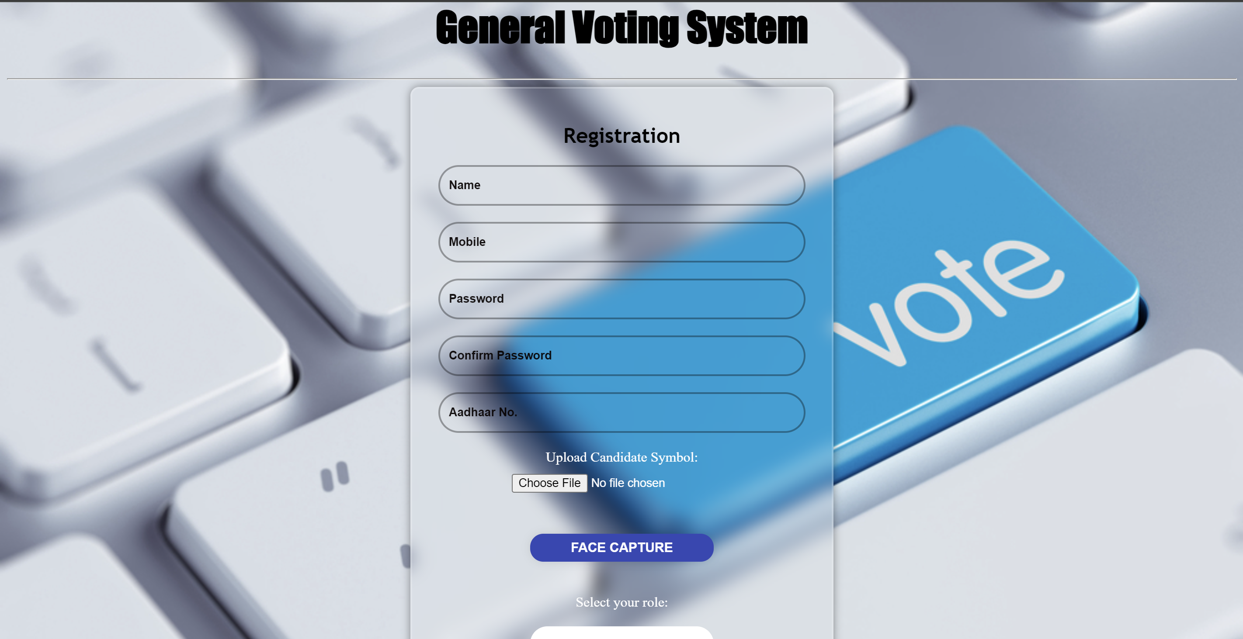
Registration Page

Slide 21
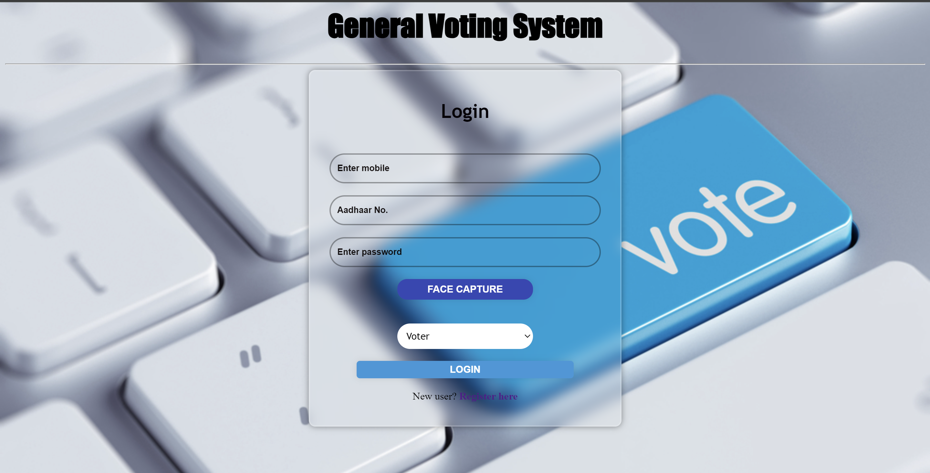
Login Page

Slide 22
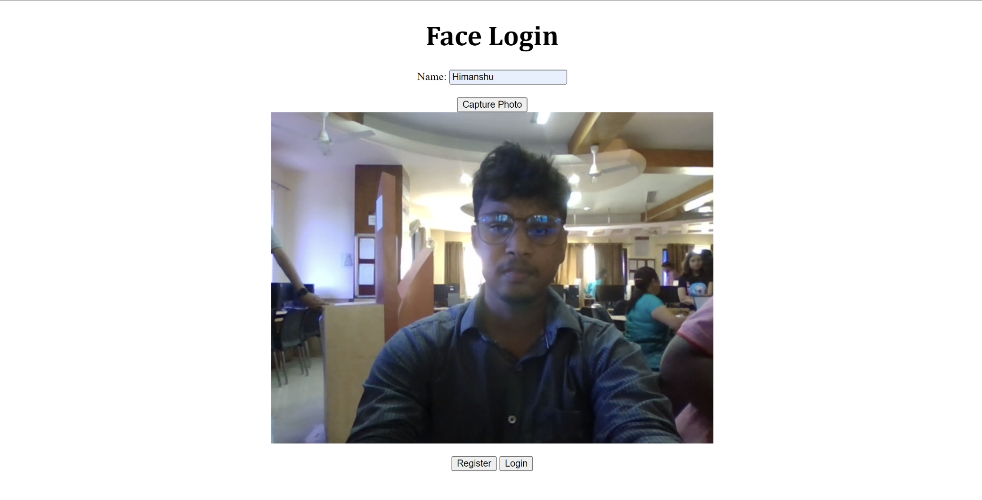
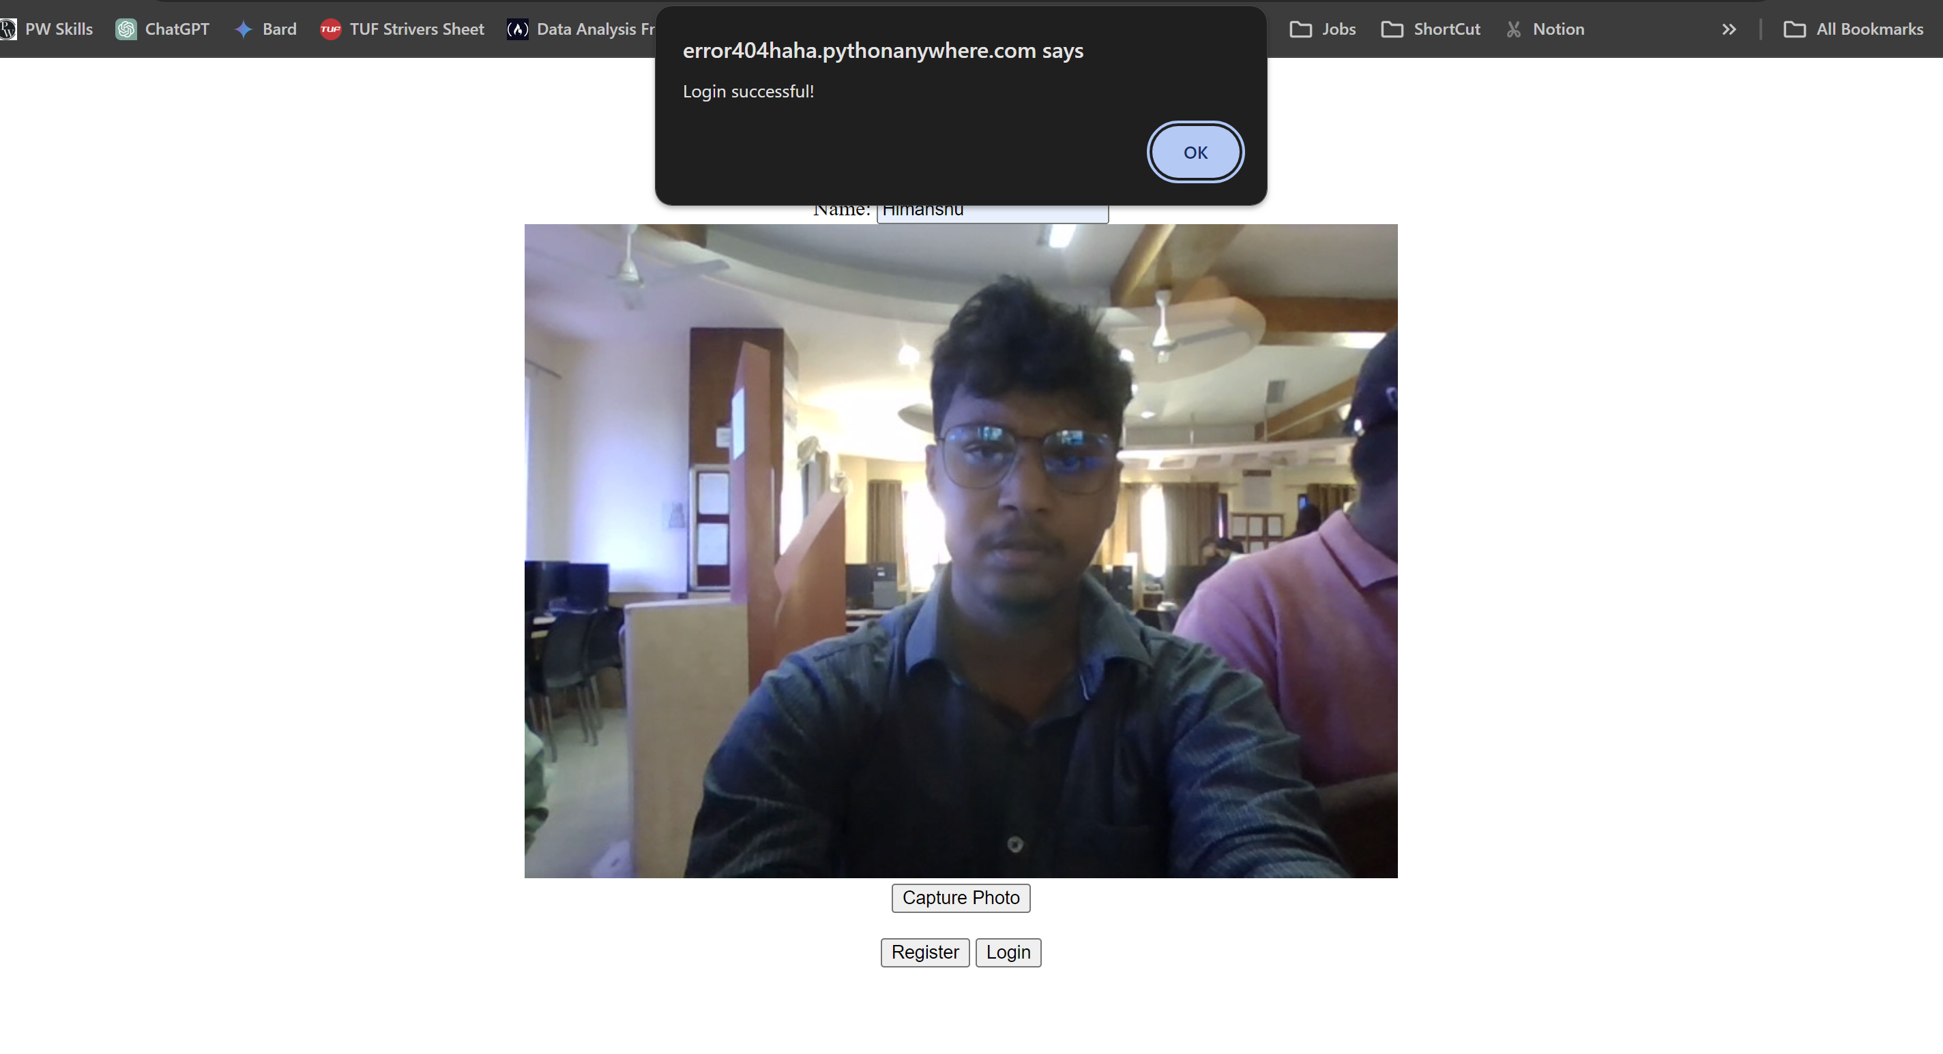
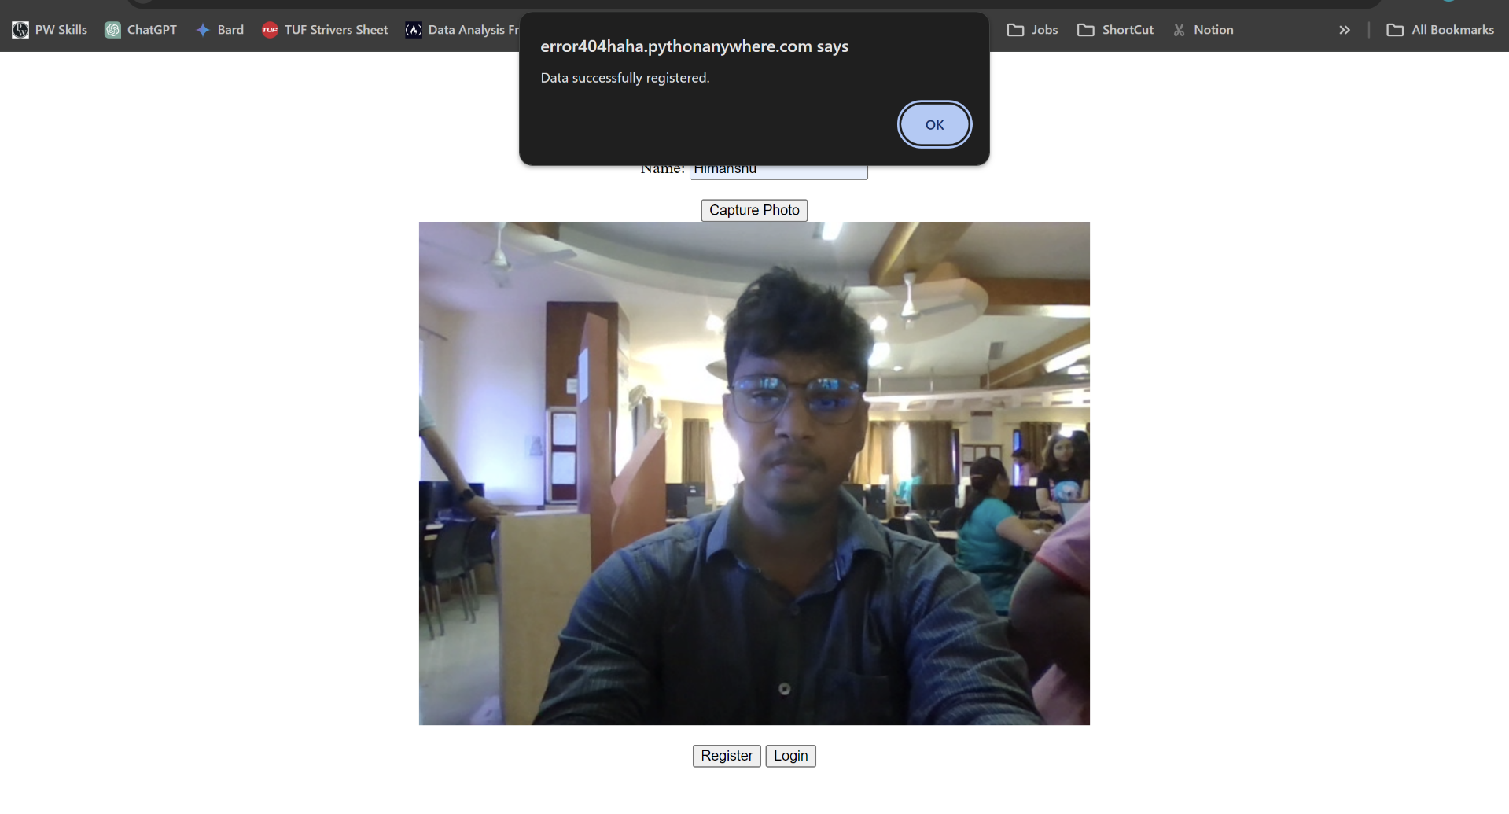
FACE VERIFICATION

Slide 23
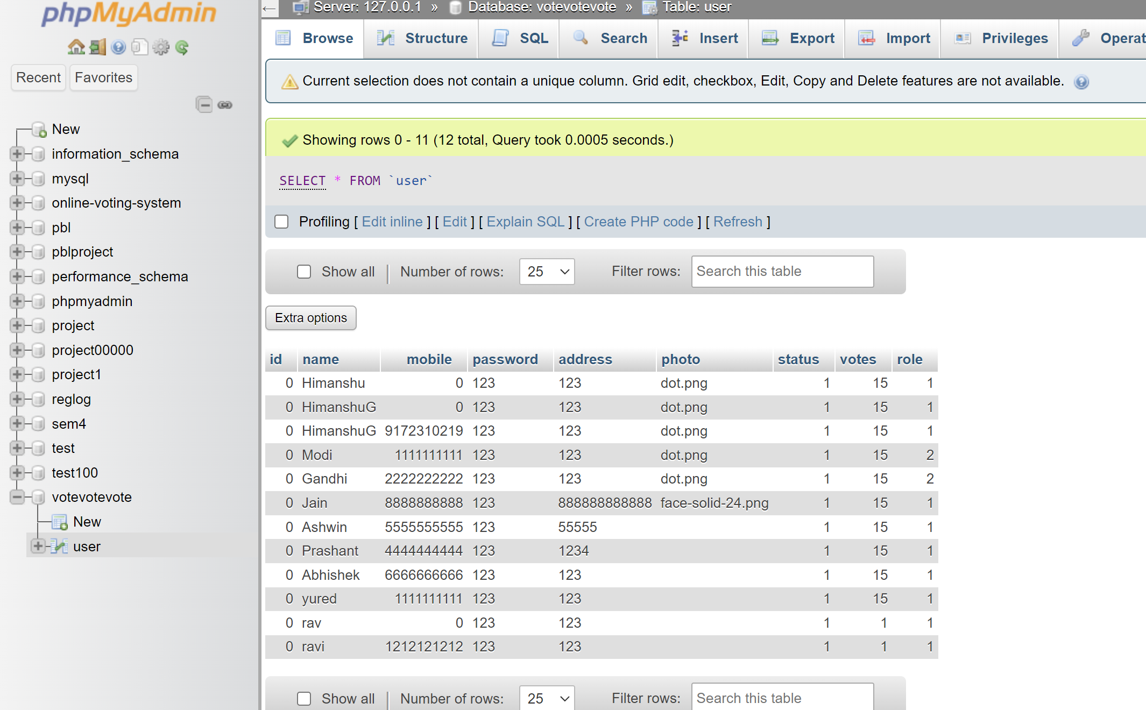
MySQL Database

Slide 24
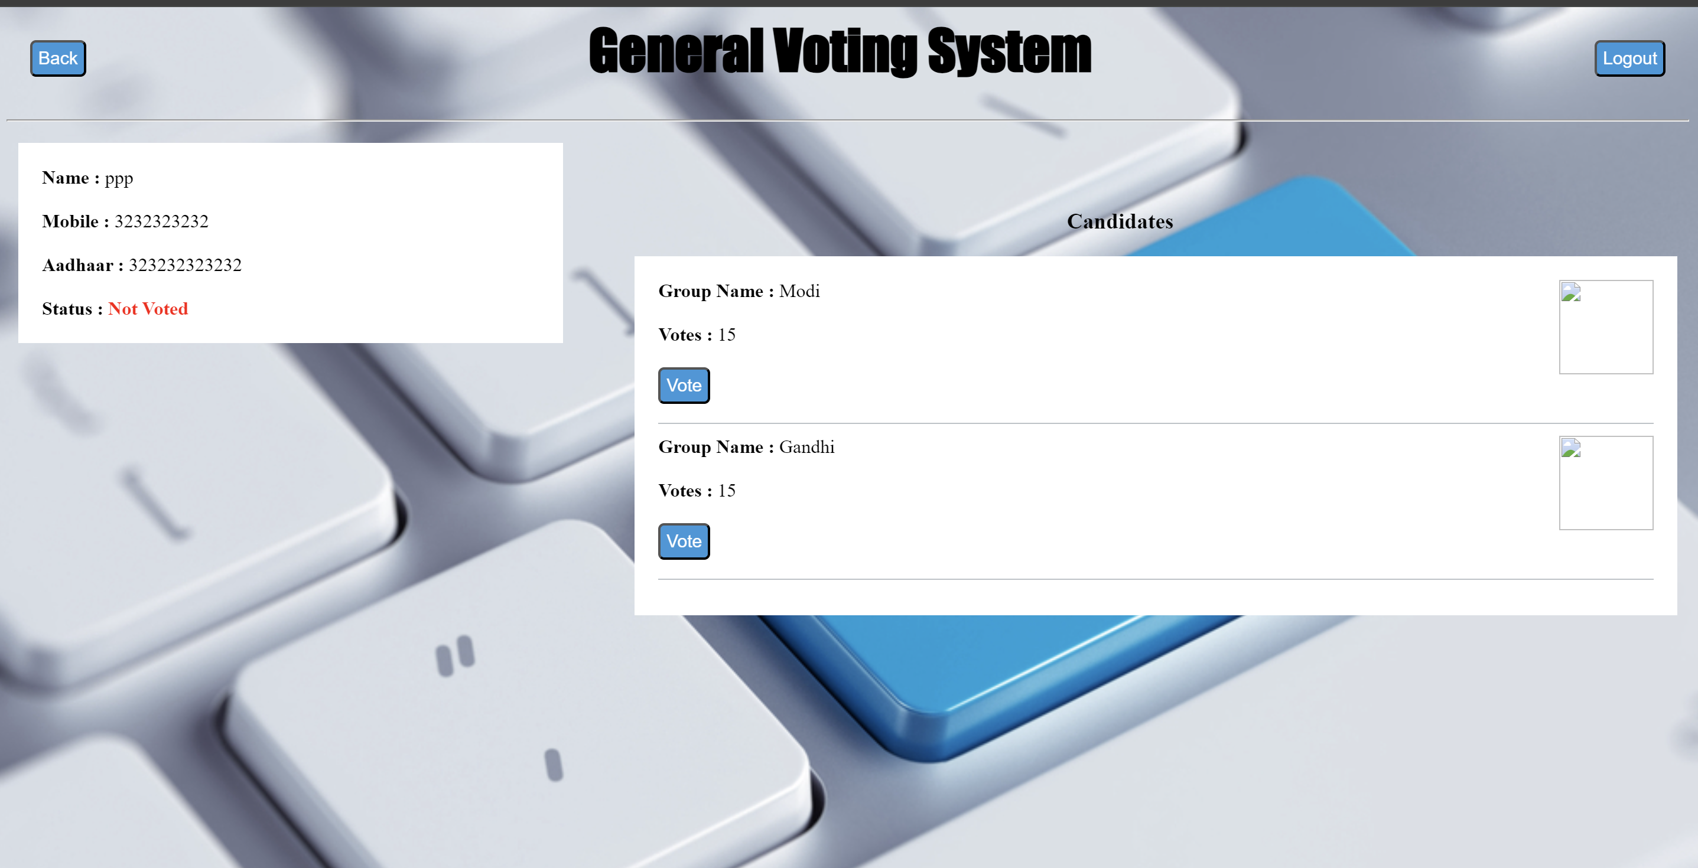
DASHBOARD

Slide 25
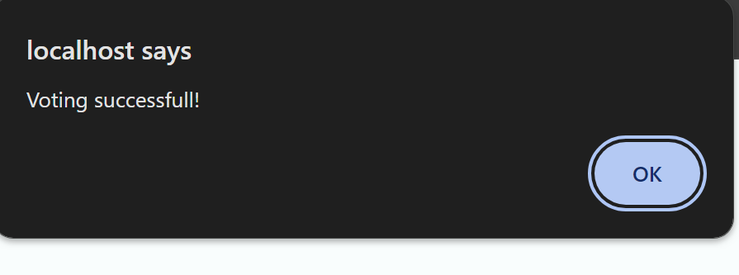
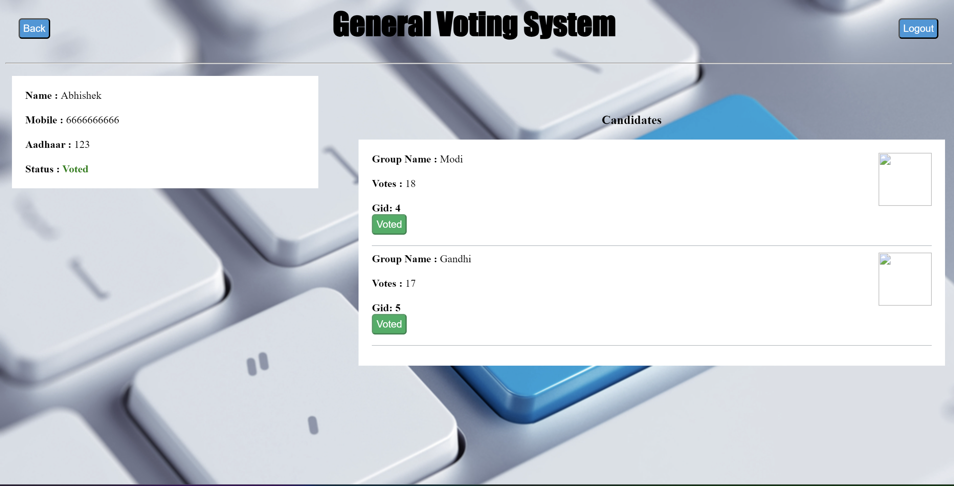
DASHBOARD

Slide 26
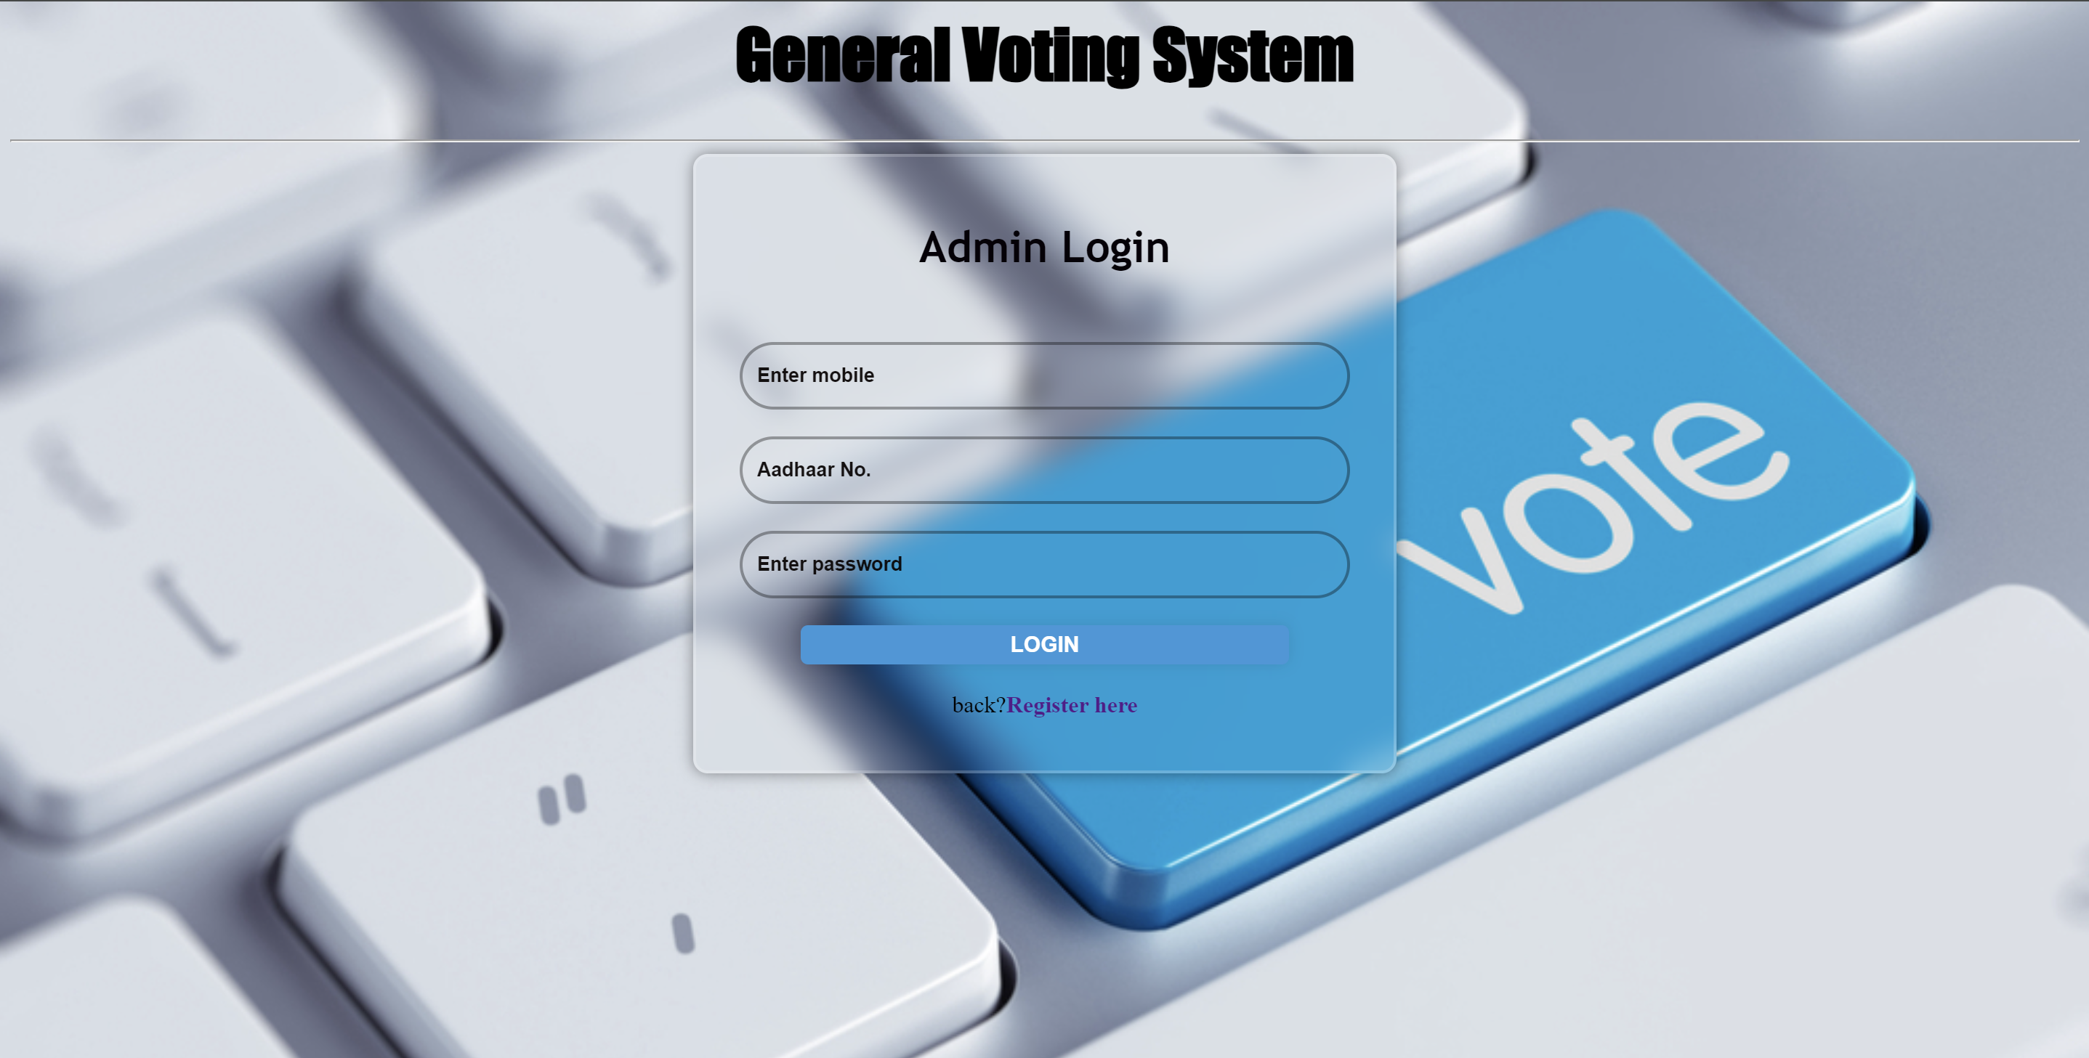
Admin Login

Slide 27

RESULT PAGE

Slide 28
Conclusion
In conclusion, the Online Voting System is a robust and efficient solution for conducting voting processes over the internet. The system provides various features such as user registration, login, and voting options, and ensures security and data privacy. The development of the system involved extensive research and analysis of existing systems, and the implementation of various software design and development principles.
The project team carried out thorough testing of the system, including black box testing, data validation test cases, white box testing, and functional validation test cases. The testing was successful, and the system met all the expected standards and requirements.
Overall, the Online Voting System is a highly useful and innovative solution that can help save time, energy, and cost associated with traditional voting methods. It has the potential to improve the efficiency and transparency of voting processes, making it a valuable tool for governments, organizations, and communities.

Slide 29
DYPCOE_AKURDI VOTING SYSTEM FOR GENERAL ELECTION PBL 2 SEM 4
REFERENCES
Shahandashti S. F. and Hao, F. (2016). DRE-ip: A Verifiable E-Voting Scheme Without Tallying
Kiayias, A. and Yung, M. (2002) Self-tallying Elections and Perfect Ballot Secrecy. Berlin, Heidelberg:Springer Berlin Heidelberg, 2002, pp. 141{158.
Adida, B.; ‘Helios (2008). Web-based open-audit voting, in Proceedings of the 17th Conference onSecurity Symposium, ser. SS'08. Berkeley, CA, USA: USENIX Association, 2008, pp. 335{348.
Journal of Computer Engineering and Applications, August 2015

